Slide 1
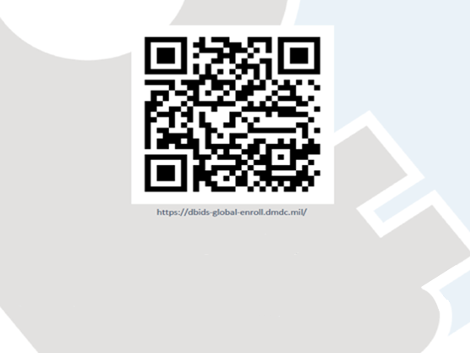
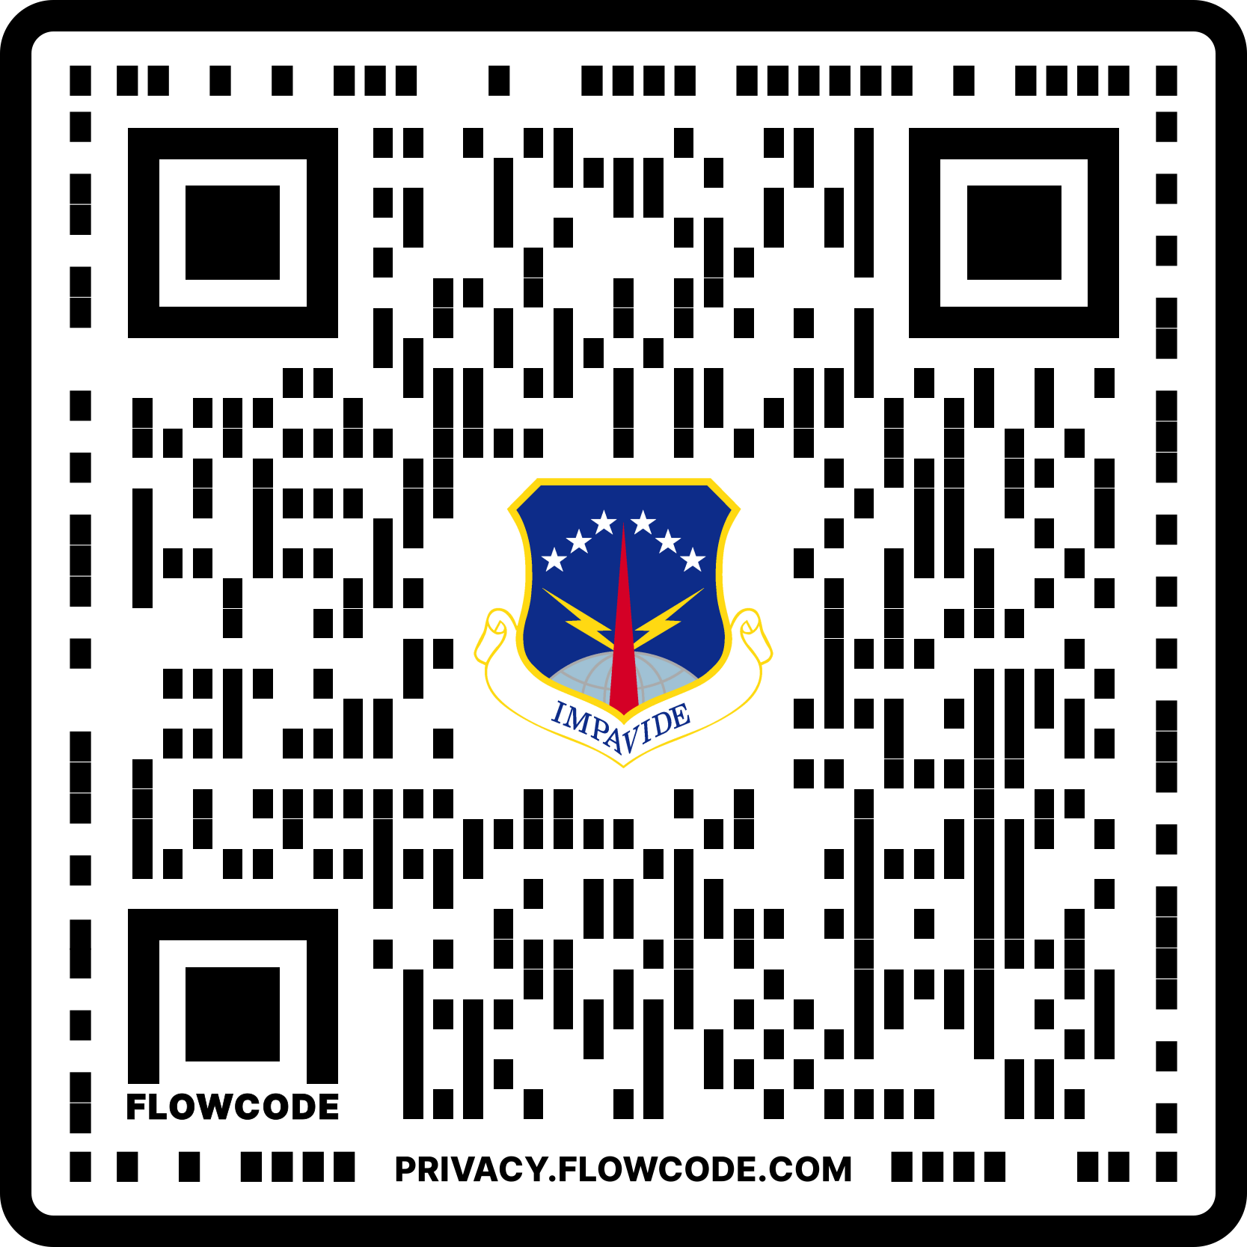
NEED A VISITOR’S PASS? WANT TO AVOID THE WAIT AT THE GATE? NEW PROCESS BELOW!
OR GO TO:
www.warren.af.mil/Base-Access
HOW TO
Sponsor or visitor go to above QR Code, and follow steps listed for each visitor
(NLT 3 business days before needing the pass) Email the following documents to 90sfs.s5.s5communications@us.af.mil or hand carry to Bldg. 290, Pass & ID, M-F 0800-1600:
Unique QR Codes (generated via DBIDs enrollment)
Photocopy of front/back of visitor’s government/state issued ID (ex: Driver’s License)
Filled out FE Warren Visitor Pass Request Form (found at the QR Code)
If visitor passes a background check, the sponsor will receive a return email with passes attached

